Slide 1
Chapter 13
Controlling Congestion

Slide 2

Divide And Conquer
The Internet is highly complex, in terms of …
  its sheer size
  the number of (internal) tasks it needs to manage: routing, congestion control, packet reordering, connection establishment …
Tasks are structured through modularization
  break down into smaller pieces
  create different functional layers

Slide 3
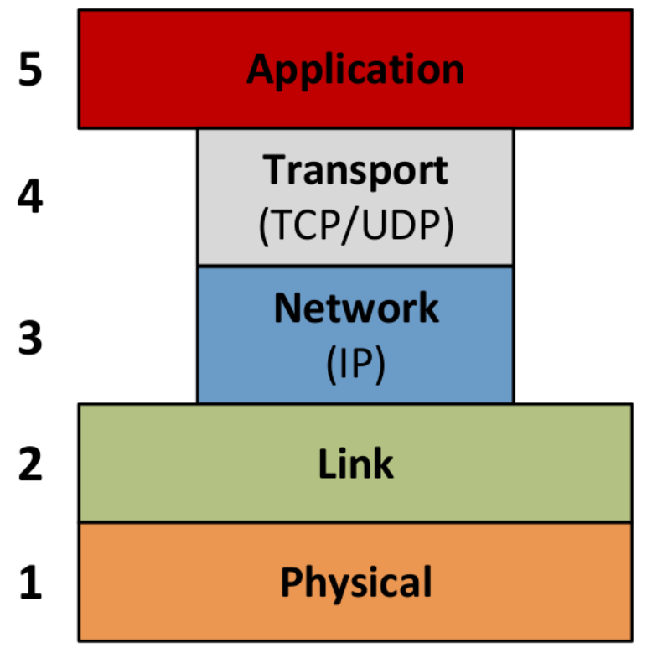
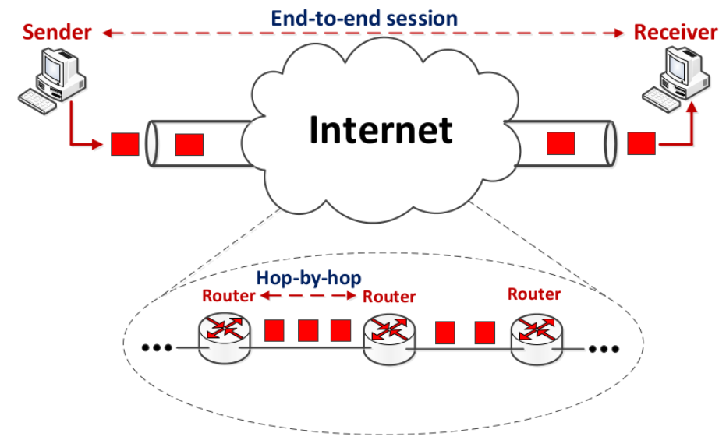
Layered Protocol Stack
5-layer model
Physical layer
  network medium (fiber, wireless, …)
Link (MAC) layer
  manage access to network medium (802.2, 802.11, etc.)
Network layer
  handles routing (IP)
Transport layer
  end-to-end management (TCP)
Application layer
  what we interact with (e.g., HTTP)

Slide 4
Layered Protocol Stack
Each layer …
  provides service to layer above
  uses service from layer below
Horizontal lines
  very complicated objects
  represent limitations of what layers can do and see
Not “clear-cut” division
  e.g., error control (can be done at multiple layers)
  ensures robustness

Slide 5
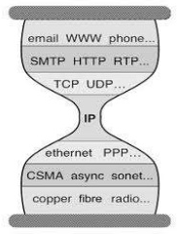
Transport & Network
“Thin waist”
  TCP/IP: stayed mostly the same
  other layers: evolved dramatically
Transport layer
  end-to-end (host-to-host)
  connection-oriented in TCP
Network layer
  hop-by-hop
  connectionless in IP

Slide 6
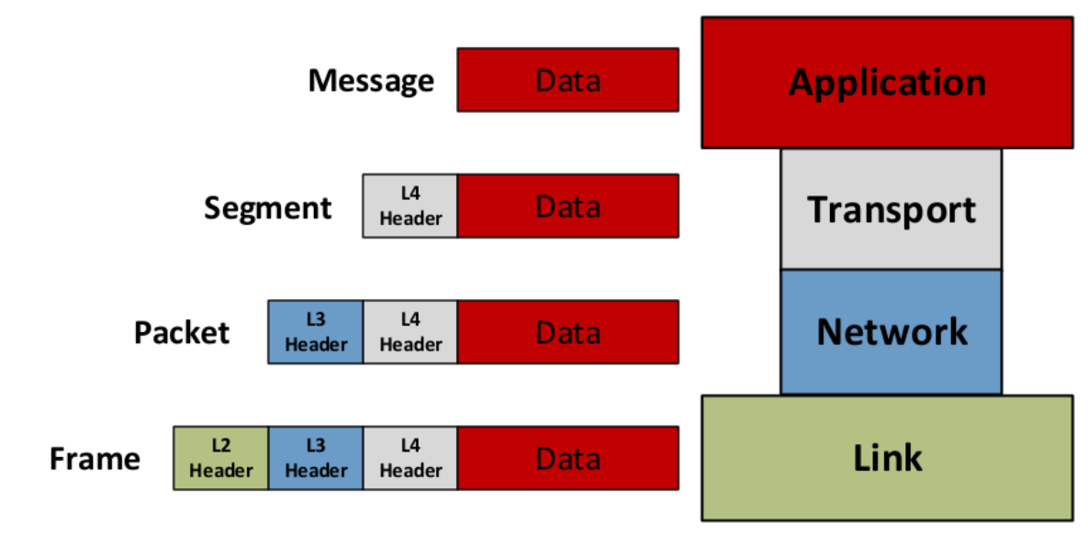
Headers
Encapsulate: augment data with headers
  payload: actual content
  header: identification and control information
This creates overhead, but why bother?
  allows us to distinguish messages
  e.g.: layer 3 header contains src & dst IP addresses of next hop
  essential for packet forwarding (switching)

Slide 7
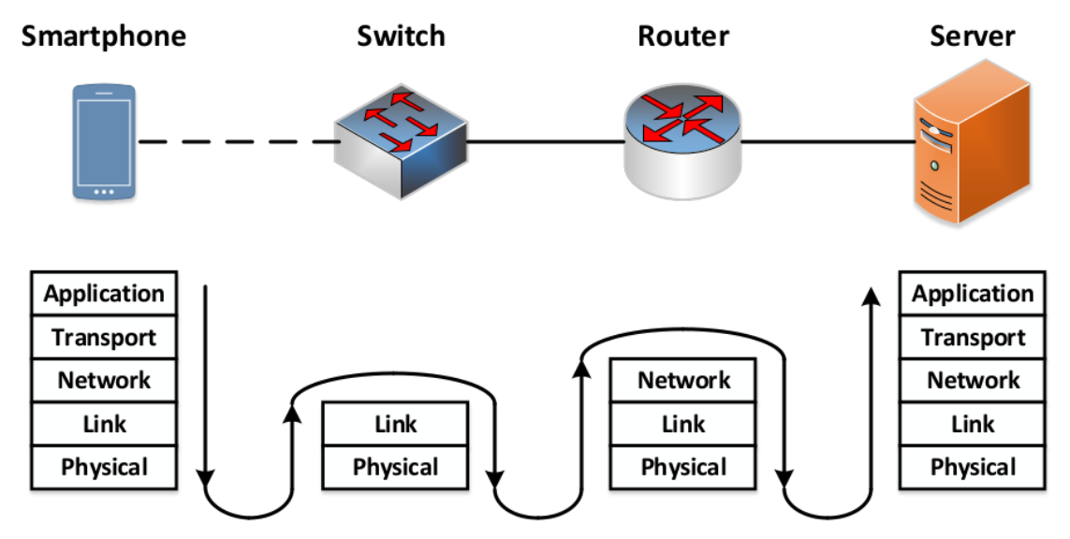
“Understanding” Layers
Different network elements process up to different layers
End-hosts
  server, computer
  process all 5 layers
Routers
  up to layer 3
  have IP addresses
Switches
  up to layer 2
  do not have or process IP

Slide 8
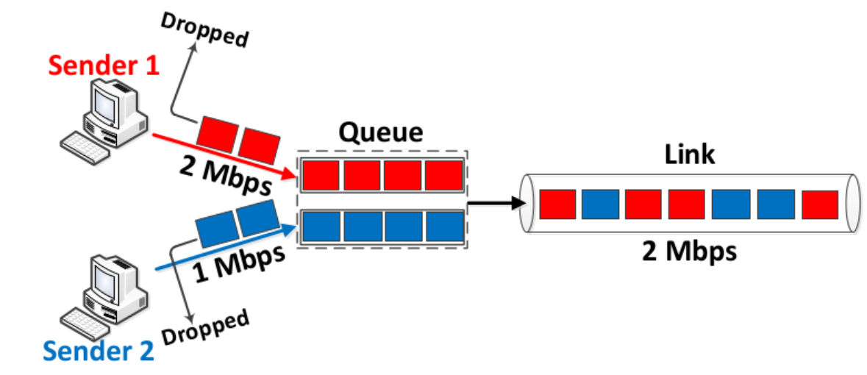
Controlling Congestion
Congestion control is left to the transport layer
  make sure nobody is “asking” for too much
  don’t let demand exceed supply!
Measure capacity and demand in bps
When demand exceeds supply …
  queue fills up
  packets are dropped

Slide 9
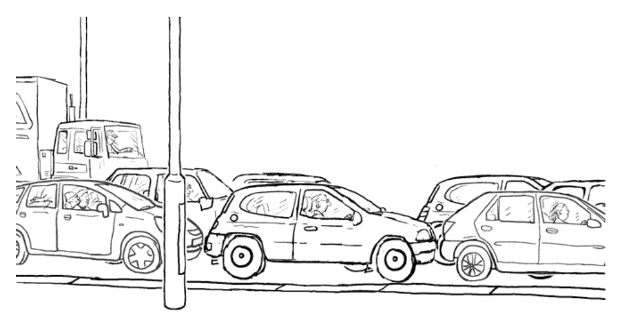
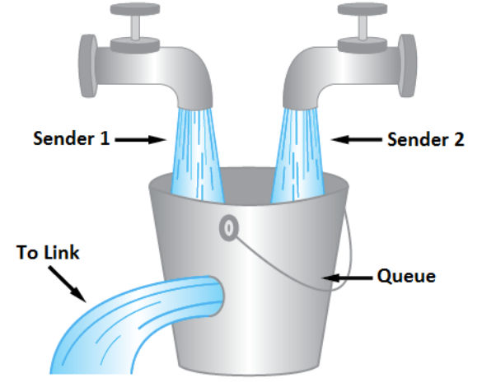
Traffic Jam and Bucket
Traffic jam
  too many cars (packets) on the road (network)
  wait and inch slowly (queued)
  eventually exit (transmitted)
Congestion builds up
Bucket with leak
  hole (link) can only handle so much (capacity)
  fill up bucket (queued)
  overflow bucket (dropped)

Slide 10
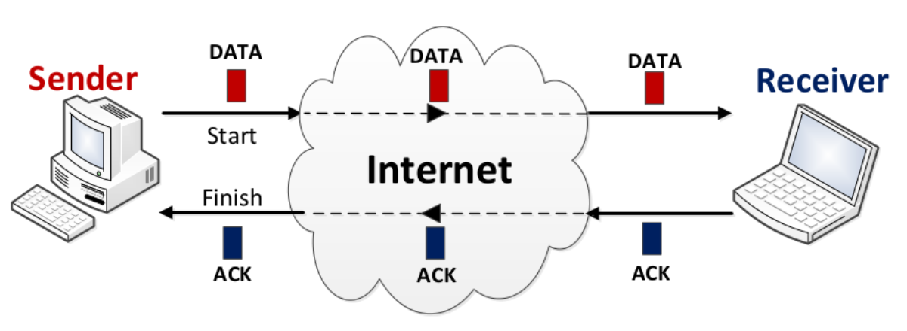
End-Hosts
End-to-end principle: have …
  “intelligent” end hosts
  “dumb” core network
The senders manage …
  end-to-end connections
  congestion
Receiver host provides “hints”
  acknowledgement (ACK) packets
  sent back upon proper receipt
  presence or not and timing help infer congestion

Slide 11
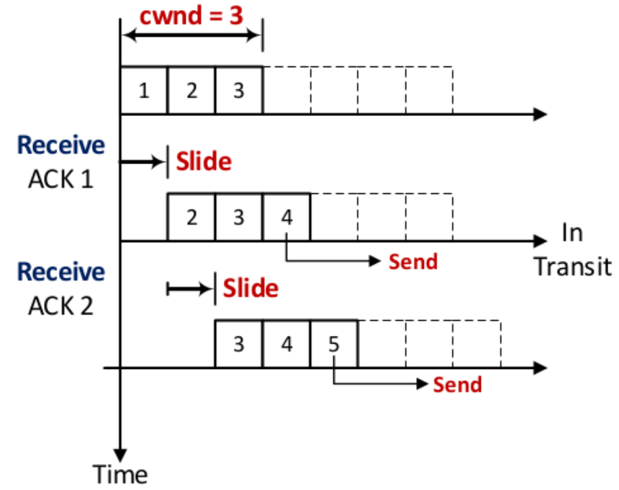
Sliding Window
Under TCP, each sender keeps a congestion window
  Limit on # outstanding (unacknowledged) packets a device can have
  When ACK received, slide and send
  Similar to Netflix DVD policy
    allow you a fixed number of movies at one time
    return one to rent a new one
    pay more for larger “window”

Slide 12
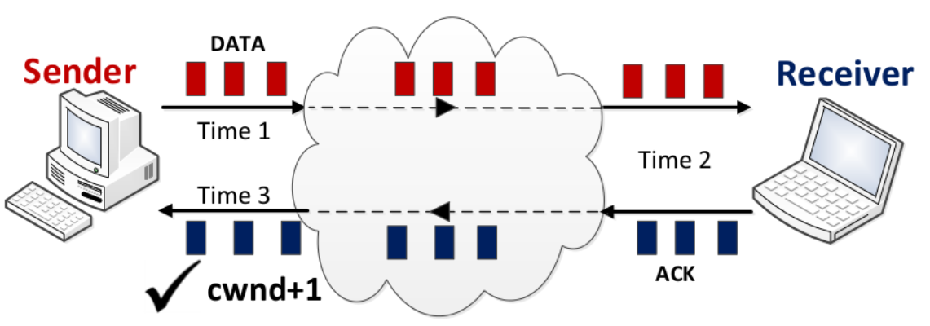
Cautious Growth of Window
Under no congestion, cwnd should grow
  efficiently utilize the network
  TCP increases it linearly
Increase cwnd …
  by 1 if all outstanding packets received
  by 1/cwnd for every packet that comes back
Note that this is in addition to sliding!

Slide 13
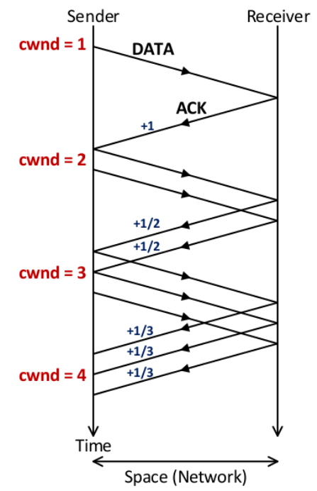
Space-Time Diagram
Illustrate windowing with space-time diagram
If there is congestion …
  have to reduce cwnd
  TCP advocates multiplicative decrease
Cautious growth
  additive increase, multiplicative decrease (AIMD)
Similar to DVD rentals
  increase allowance slowly as you return
  decrease drastically as you fail to return

Slide 14
Congestion Control
All of the main congestion control algorithms use a sliding window controlled by negative feedback to regulate transmission rates
Congestion control algorithms diverge in how congestion is inferred
Congestion control is accomplished in a distributed manner, with each end host controlling its window size through negative feedback

Slide 15

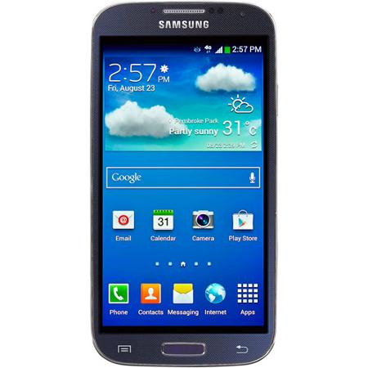
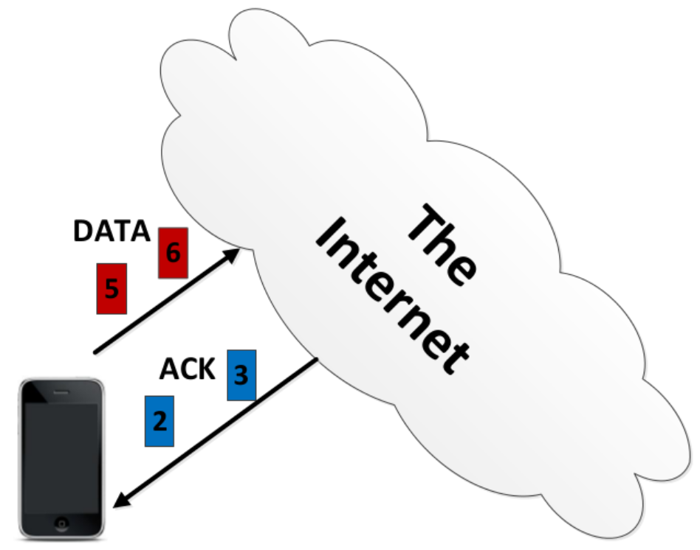
How to Infer Congestion?
End-host doesn’t know what the network looks like
  no idea about paths …
  no idea about other hosts …
  no idea about traffic …
Need to infer congestion from feedback (i.e., ACKs)
How to infer congestion?
  packet loss as signal

Slide 16
Packet Loss as Signal
TCP Tahoe (1988) and TCP Reno (1990) assume if there’s packet loss, then there’s congestion
Since a successful acknowledgement means a packet was delivered, then the lack of an ACK should mean packet was lost
How can we tell for sure that no ACK has been sent?
  ACK is delayed or sent but got lost
  Use two common-sense approximations to make reasonable guess as to whether a packet has been lost or not

Slide 17
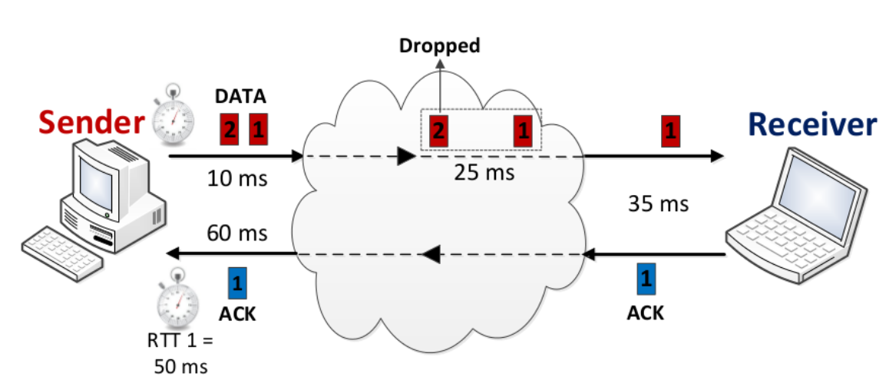
Approximation 1
If a sender waits a long time with no ACK, packet was probably lost
  issue: how long is “long?”
  Round Trip Time (RTT): time from sender to receiver and back
  timeout counter: larger than “normal” RTT (maybe 3x)
  “normal” RTT: could be (recent) minimum RTT
@
@
Packet 1 was ACKed 50 ms after it is sent

Slide 18
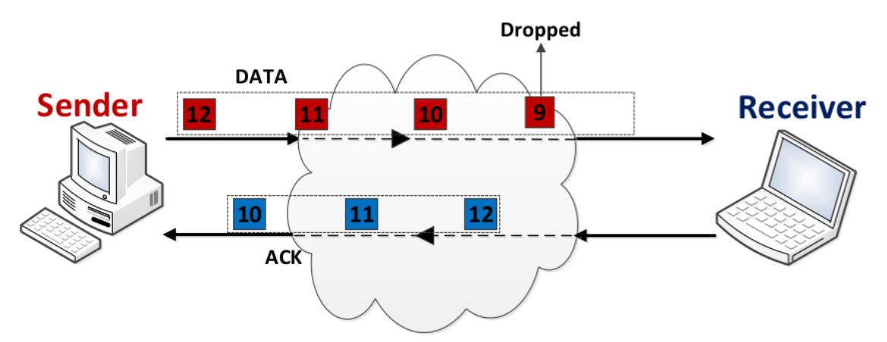
Approximation 2
If sender received ACK for many future packets, packet was probably lost
  assign each packet a sequence number
  assume loss after a certain number of future packets (maybe 3)

Slide 19
TCP Congestion Control Versions
Loss-based (was packet lost, or not?)
  all-or-nothing
  1988 – TCP Tahoe – Van Jacobson
  1990 – TCP Reno
Problems
  often too late (to react to congestion) by the time losses are occurring!
  poor wireless channel
Delay-based (how late/early was packet?)
  different levels of magnitude
  1995 – TCP Vegas
  2002 – FAST TCP – helped stabilize congestion control
  2005 – CUBIC – combined loss- and delay- based signals
  2012 – TCP Proportional Rate reduction (default in Linux)

Slide 20
Loss-Based Congestion Inference
TCP Reno – Widely used in Windows OS
Each RTT: have all packets been received properly?
  Yes – Increase cwnd by 1
  No – Cut cwnd in half
What is “not properly”?
  Certain number of RTTs have passed
  Certain number of future packets ACK’d

Slide 21
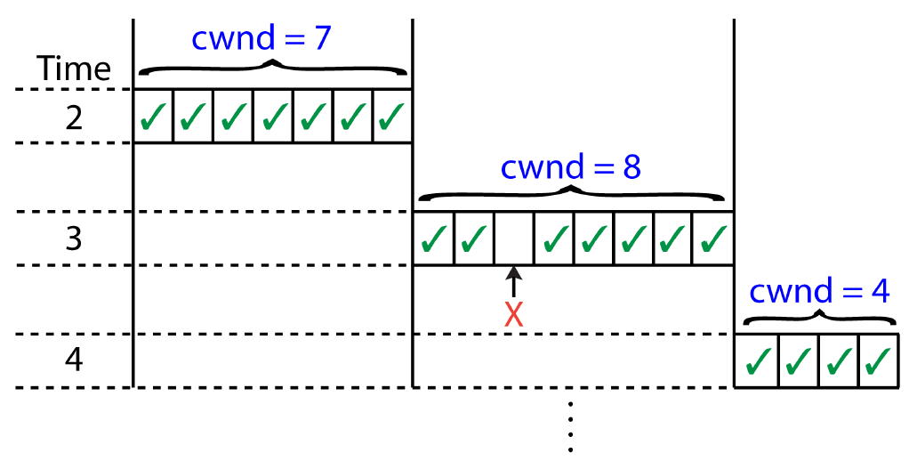
Example: TCP Reno
Time 0: cwnd = 5
Time 1: Receives 5 ACKs
Time 2: Receives 6 ACKs
Time 3: Receives 7 ACKs
Time 4: Loss detected
Time 5: Receives 4 ACKs

Slide 22
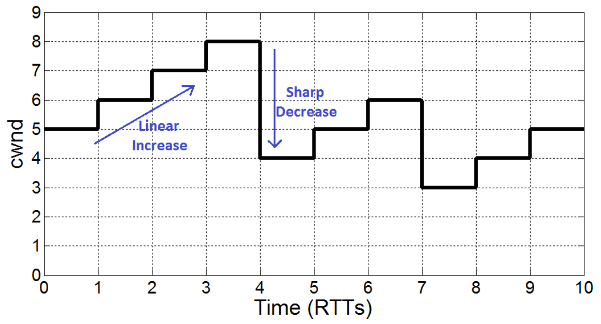
Example: TCP Reno
cwnd over time

Slide 23
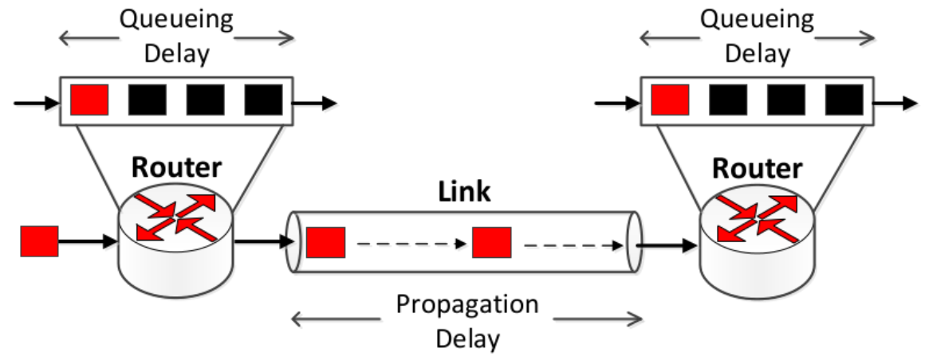
Delay-Based Congestion Inference
TCP Vegas (Linux and FreeBSD)
Two main components of RTT
  propagation delay: time it takes to go through links – invariant with congestion
  queuing delay: Time a packet waits in the queue – varies with congestion

Slide 24
Delay-Based Congestion Inference
Queuing delay: estimated by comparing no-congestion RTT to current RTT
TCP Vegas: compares transmission rates (cwnd/RTT)
  current: cwnd/curRTT
  no-congestion: cwnd/minRTT
  subtracting gives difference
Each acknowledgement: compare difference to some threshold (say 3 packets/sec)
  If smaller, then increase cwnd by 1 (close to ideal)
  If larger, decrease cwnd by 1 (far from ideal)
  If the same, keep cwnd the same

Slide 25
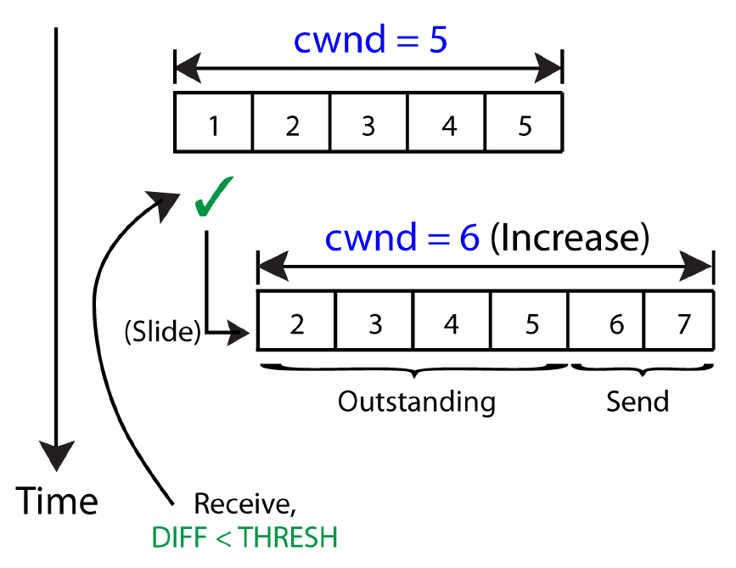
TCP Vegas: Example
Assume minRTT never changes (50 ms)
Initially: Sends 5 packets
@Time 1: first ACK comes back, curRTT = 51 ms
  throughput = 5/51 ms = 98.03 pkts/sec
  no-congestion throughput = 5/50 = 100 pkts/sec
  100 - 98.03 = 1.97 < 3
  cwnd++ (6)
@Time 2: second ACK comes back, curRTT = 50.5 ms
throughput = 6/50.5 ms = 118.81 pkts/sec
no-congestion throughput = 6/50 = 120 pkts/sec
120 – 118.81 = 1.19 < 3
cwnd++ (7)

Slide 26
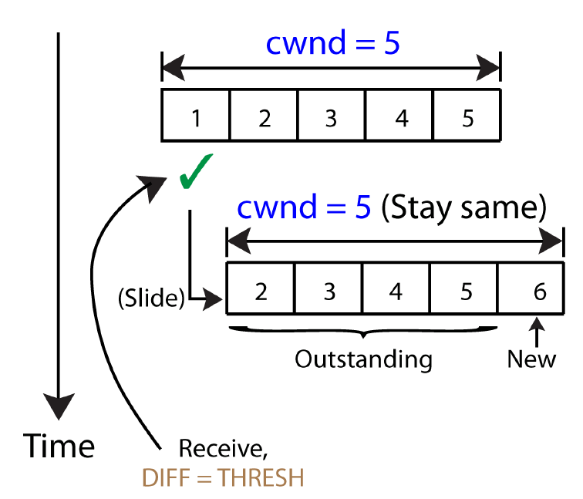
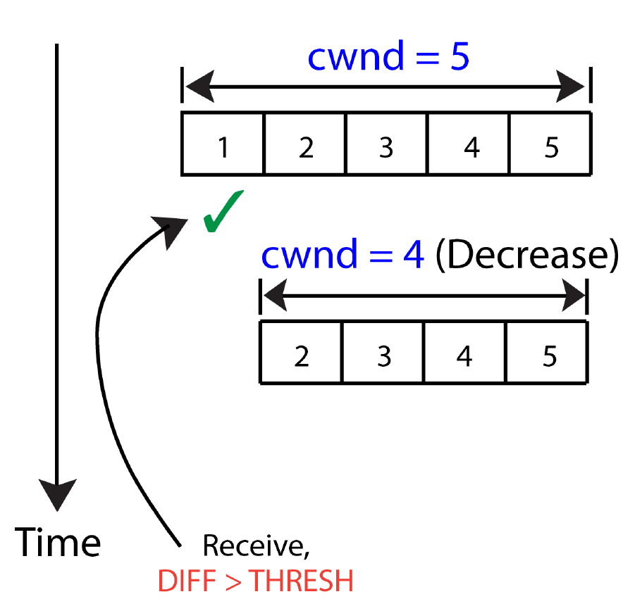
TCP Vegas: Example
@Time 3 & 4: increase cwnd to 9
@Time 5: fifth ACK comes back, curRTT = 50.8 ms
@Time 6: sixth ACK, curRTT = 51.8 ms
  throughput = 9/51.8 ms = 173.7 pkts/sec
  …
throughput = 9/50.8 ms = 177 pkts/sec
no-congestion throughput = 9/50 = 180 pkts/sec
177 – 180 = 3
cwnd stays the same (9)

Slide 27
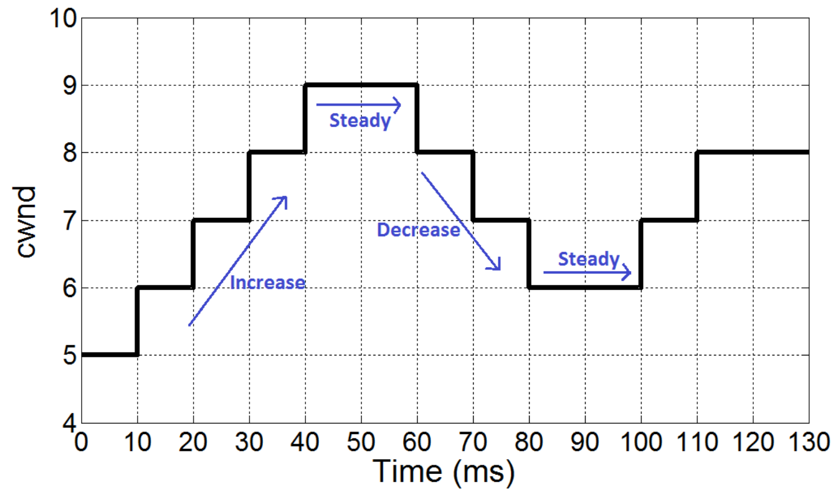
TCP Vegas: Example
70 & 80 ms: Decrease cwnd
cwnd over time
Objective is to get congestion to reasonable level
  everyone has to accept certain amount below threshold

Slide 28
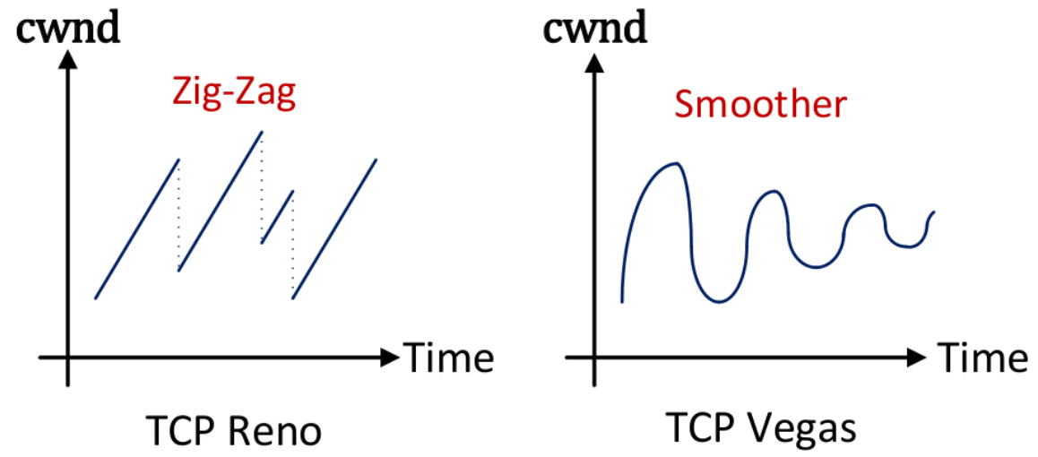
Reno vs. Vegas
Zoomed out view over time:
Comparison
  TCP Vegas generally smoothens the trajectory
  shows advantage of using non-binary congestion signal
  depends on parameters!

Slide 29
Distributed Congestion Control
Think back to Distributed Power Control (DPC)
  objective: Match measured to desired SIRs
  iterative and distributed
  can reach equilibrium among transmitters
Distributed Congestion Control
  objective: match measured to desired transmission rates

